Slide 1
CST499 Final Project
By: Kyle Mosley

Slide 2
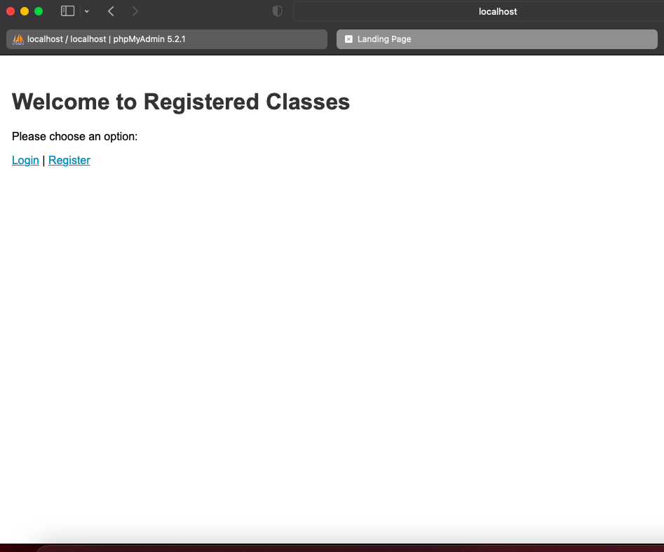
Landing Page

Slide 3
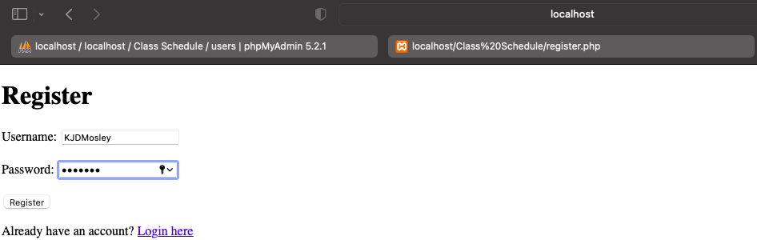
Registration Page 1/3

Slide 4
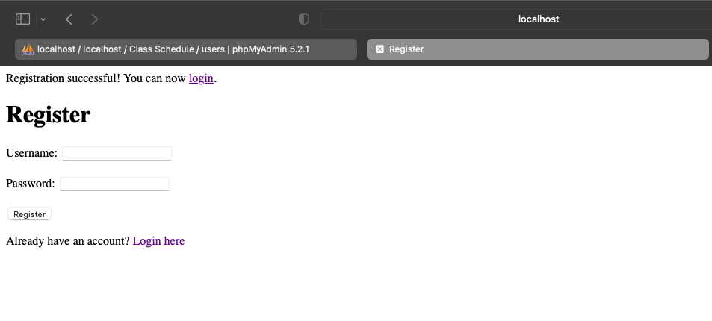
Registration Page 2/3

Slide 5
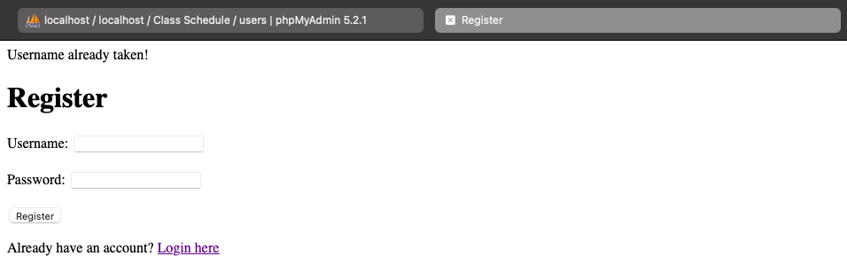
Registration Page 3/3

Slide 6
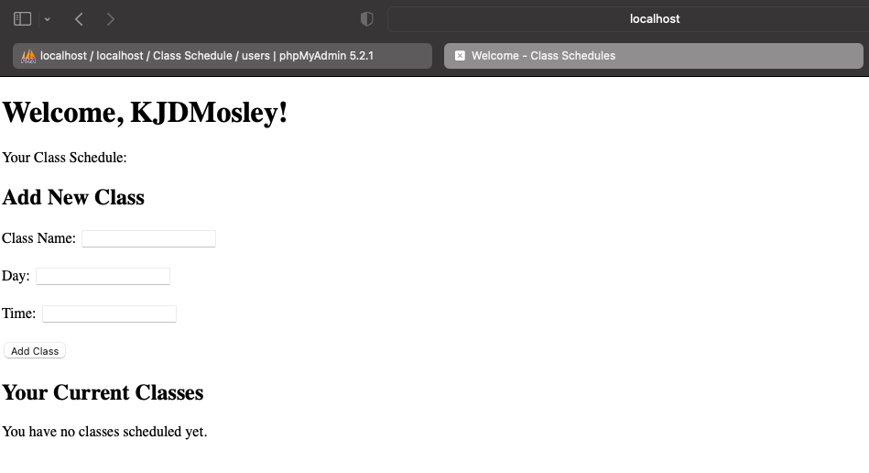
Welcome Page 1/2

Slide 7
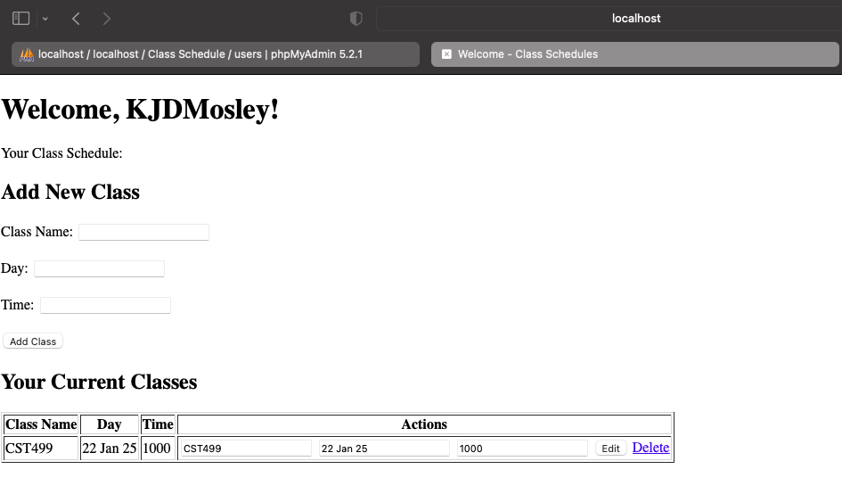
Welcome Page 2/2

Slide 8
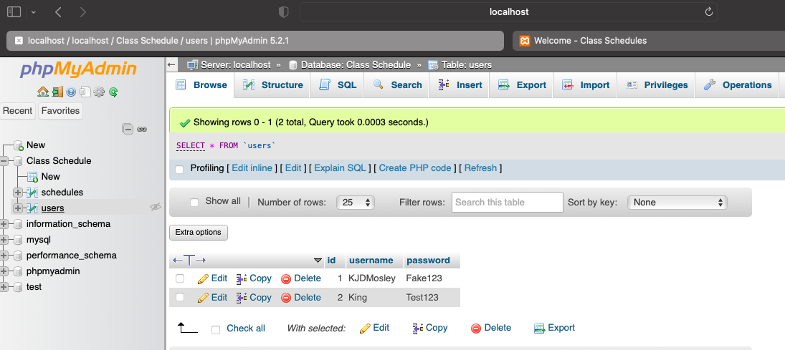
PhpMyAdmin Users Database

Slide 9
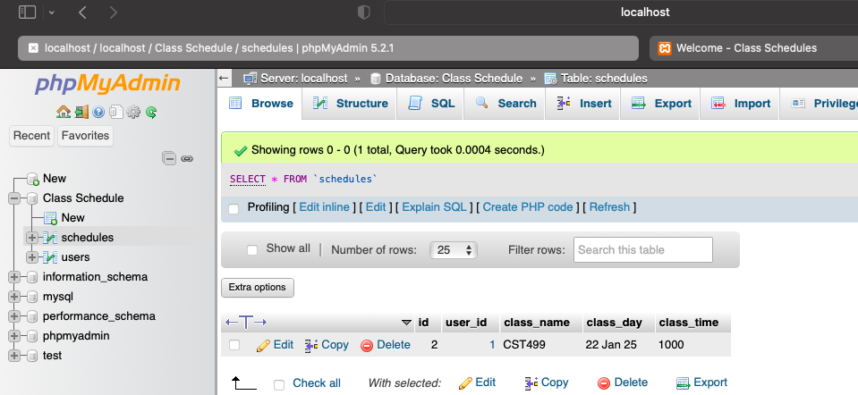
PhpMyAdmin Class Schedule Database

Slide 10
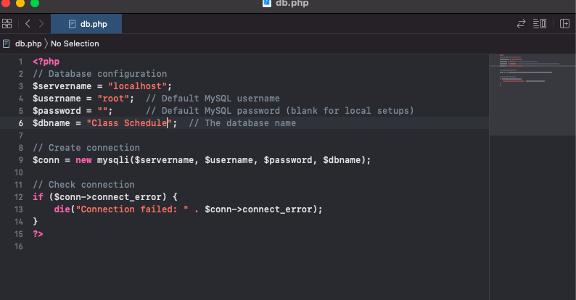
PHP Code for Database Connection 1/1

Slide 11
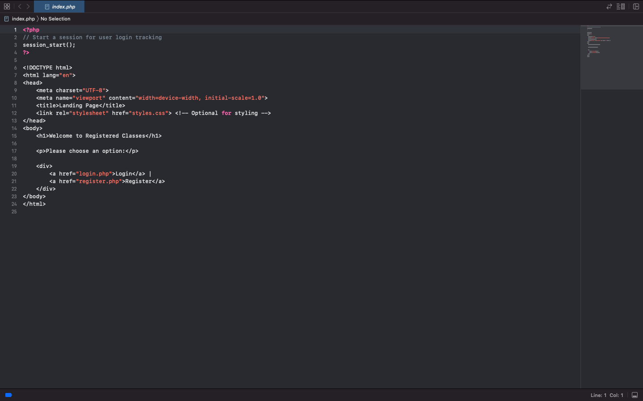
PHP Code for Landing Page 1/1

Slide 12
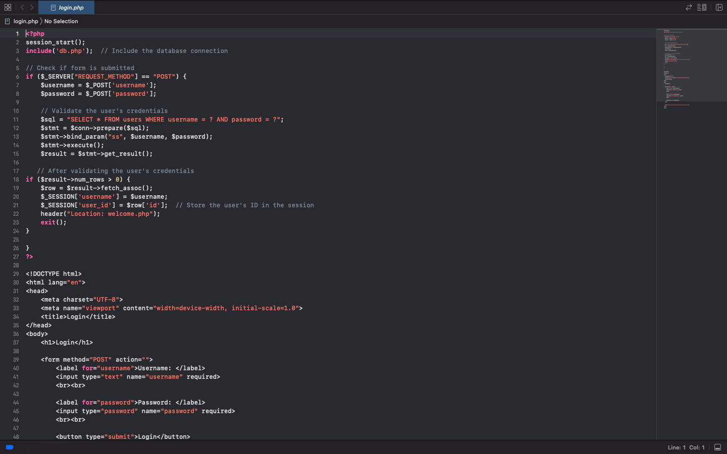
PHP Code for Login Page 1/2

Slide 13
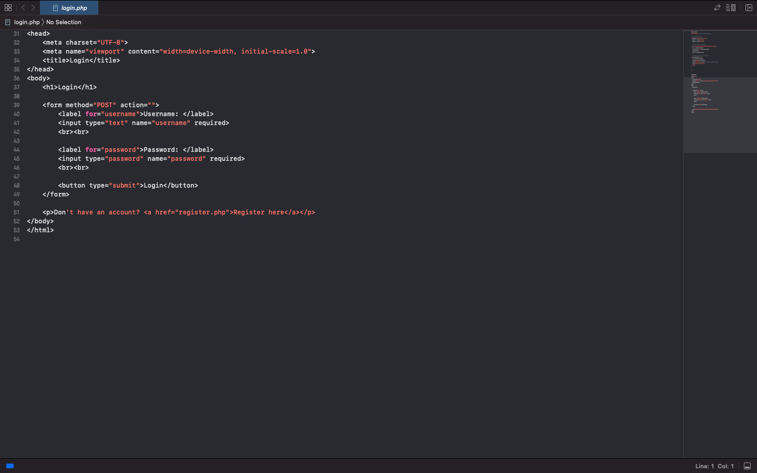
PHP Code for Login Page 2/2

Slide 14
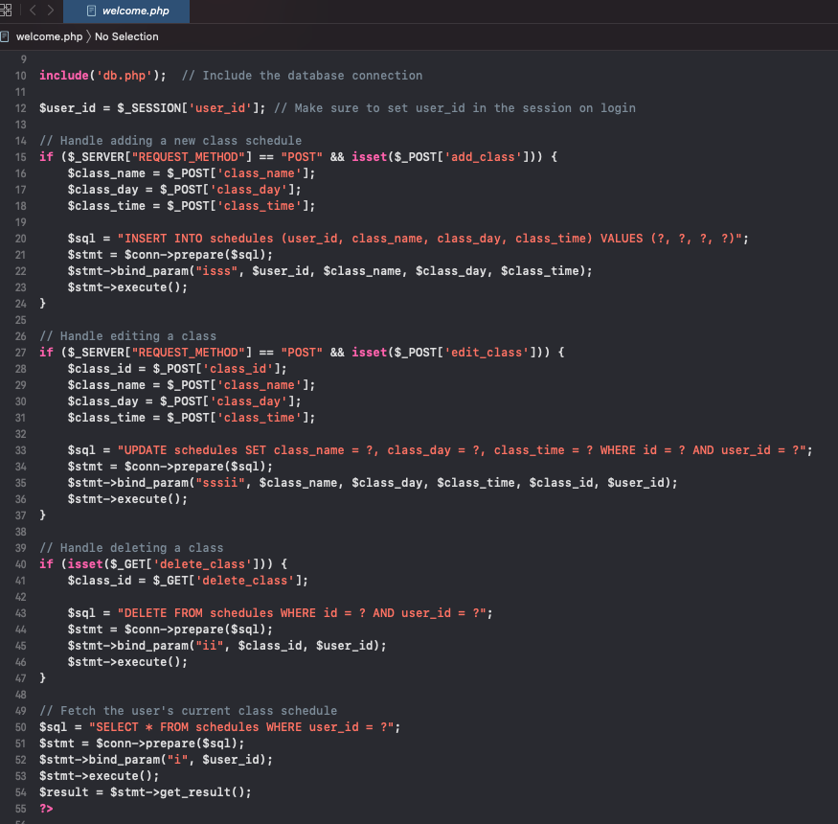
PHP Code for Welcome Page 1/3

Slide 15
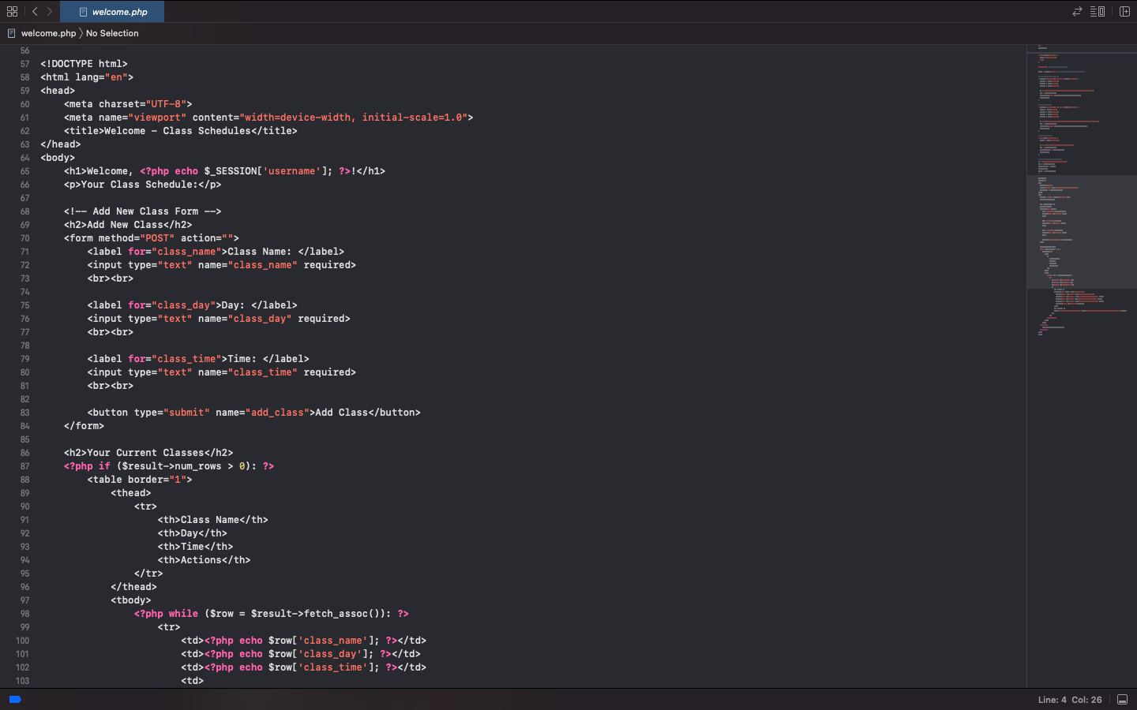
PHP Code for Welcome Page 2/3

Slide 16
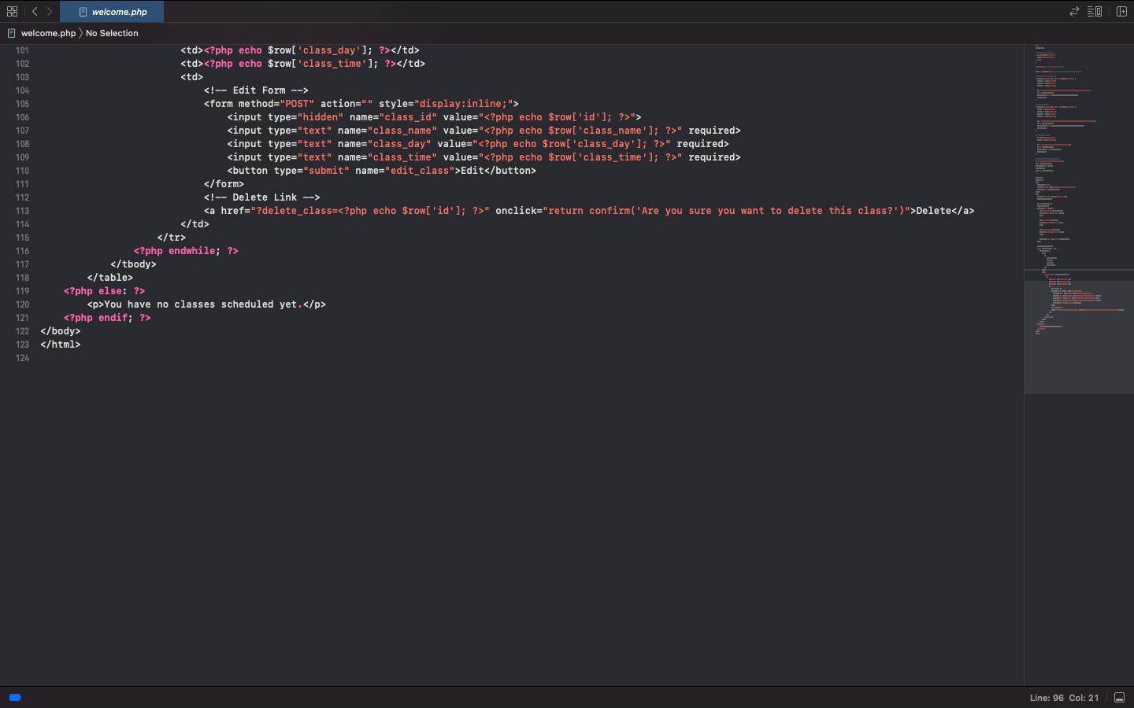
PHP Code for Welcome Page 3/3

